Slide 1
SRS and Design Presentation

Slide 2
Authors
Luiz Gadelha - 610800
Edmael Fortune - 611091
Eden Bereda - 109657
Git: https://github.com/luizfernandodag/RentCar

Slide 3
Summary
Project
The problems to be solved
Objectives
Vision
Problem Statement
Position Statement
SRS
Key Abstractions
Solution Design
VOPC Diagram

Slide 4
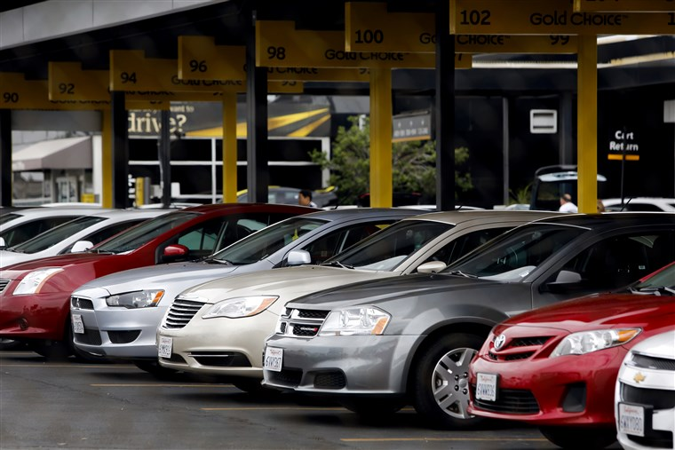
The project
Car Rent WebSystem:
CarRentMiu

Slide 5
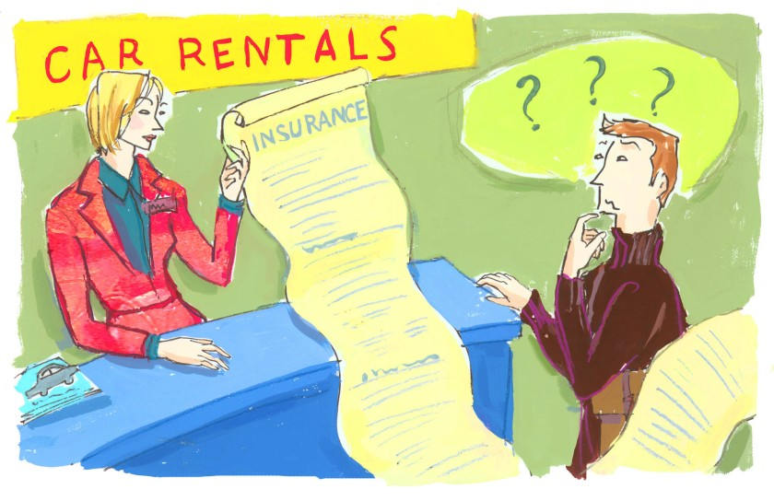
Problems to be solved
Customers could not register without contacting the office.
It is not secured.
Difficult to manage when the number of customers gets large etc.
It took time and resources

Slide 6

Objectives
Web Based system:
It increases customer satisfaction;
It saves time and resources for both users (client and customers);
Customer can register online;
Client can have a transaction history of rented and returned cars

Slide 7
Vision - Problem Statement
The problem of | Managing multiple stores by keeping track of customers, employees and cars
Affects | Employees, customers and cars
the impact of which is | Complexity of renting a car in multiple stores, managing the schedules of customers and employees
a successful solution would be | One tool which integrates facilitates: Stores managing Car registration Car rentalling Cars schedule Customer registration Clients schedule management late return cars car reservation Clients grading Clients info

Slide 8
Product Position Statement
For | Car rental store owner
Who | needs a system to manage car rental stores keeping track of customers and cars,
The | CarRentMIU
That | Is a Car Rental Management System that facilitates the management of cars rents and customers
Unlike | Paper based, hard to manage, it takes a lot of time and resources
Our Product | Web Based easy to use, saves time and resources

Slide 9
Stakeholder Summary
Name | Description | Responsibilities
Admin | The admin is the administrator of the car rental shop. Admins add, edit, delete or block customers to use the system | Responsible for setting the initial data about available cars and clients
Customer | Can see the schedule of cars. Can rent a car or set an reservation on a car | They are responsible for choosing a car, an initial and final date of rent.

Slide 10
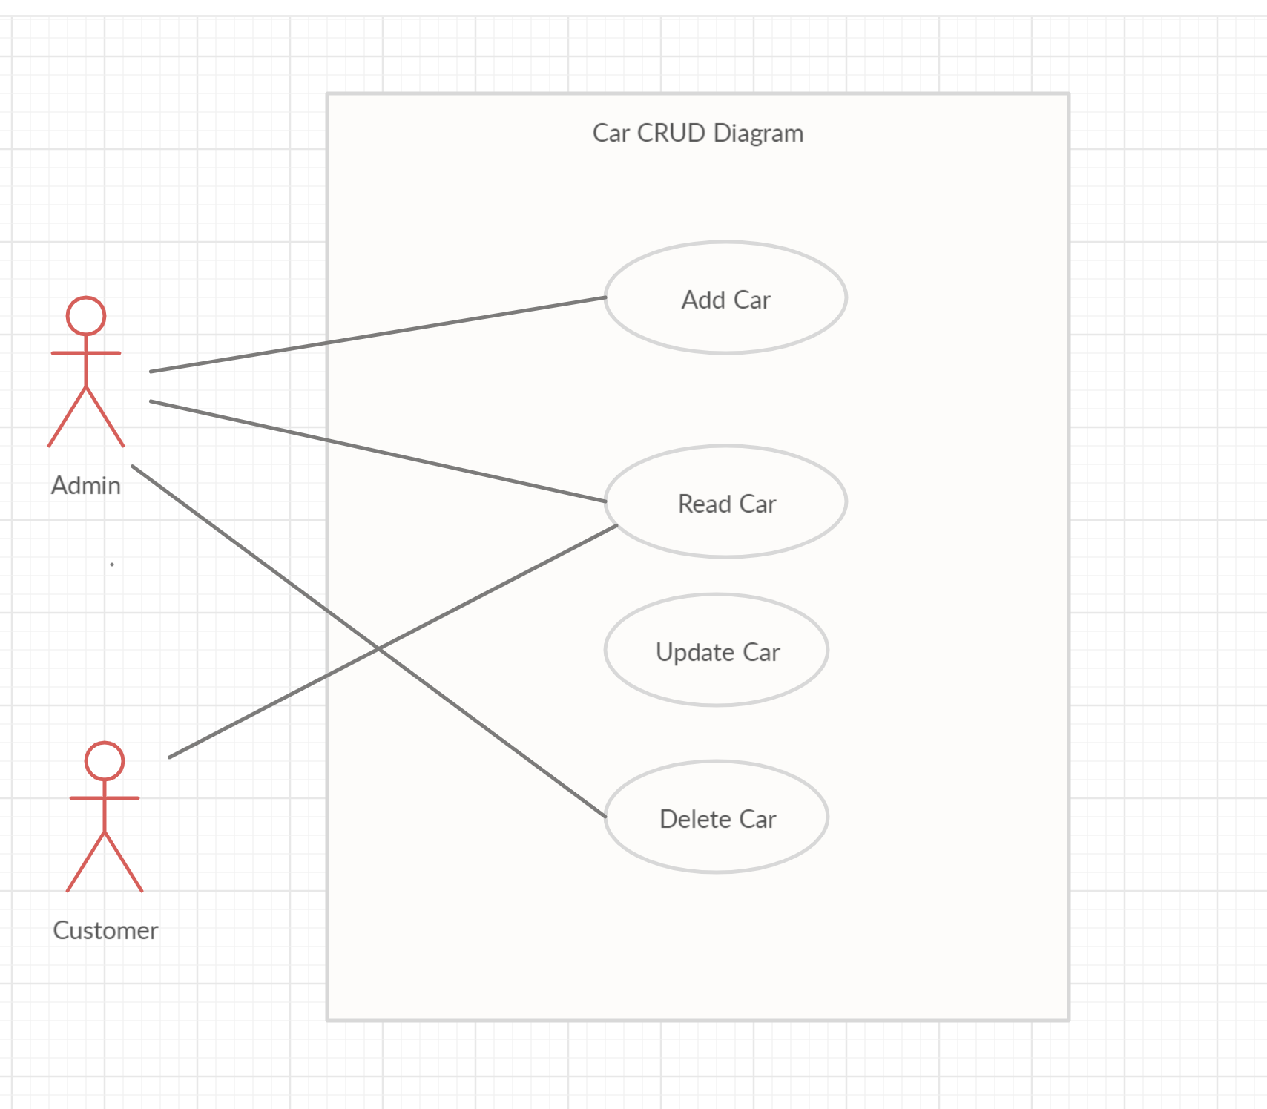
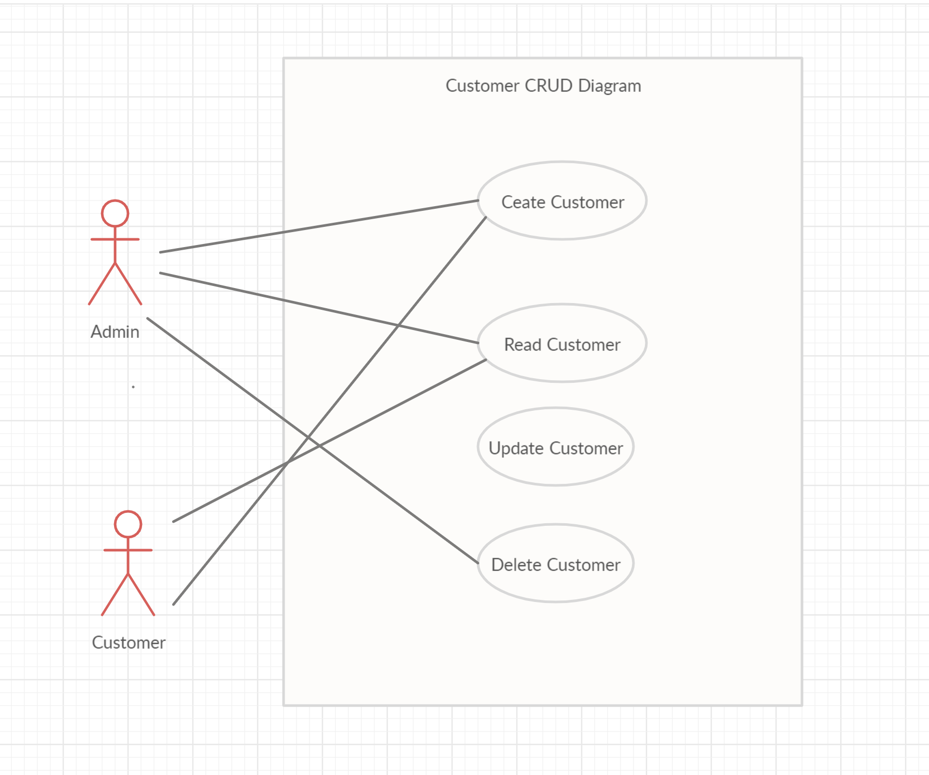
UseCases

Slide 11
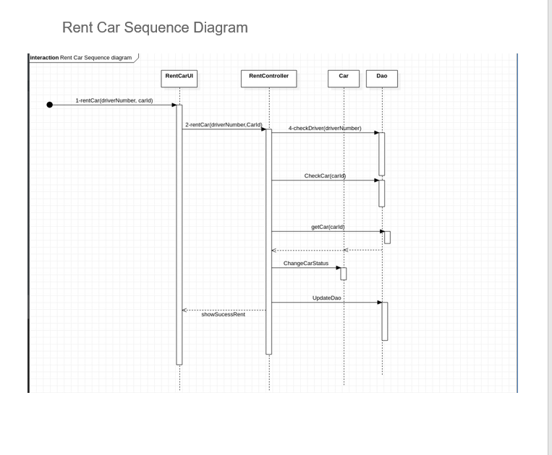

Slide 12
SRS - Architectural Mechanism
Distribution of components | Web Services - SOAP or RESTFUL
Transaction Management | JDBC
Concurrency | JEE Server or Tomcat
Persistence (Object Relational Mapping) | Hibernate or SimpleORM or Avaje
Security | Java Authentication and Authorization
Rules engine | Unknown
Wrapping of legacy systems | Unknown
Web Application Framework | SpringMVC, Angular, Vue or React
User Interface Framework | Bootstrap or Material Design

Slide 13
SRS - Key Abstractions
Customer
Admin
Car
RentTransaction

Slide 14
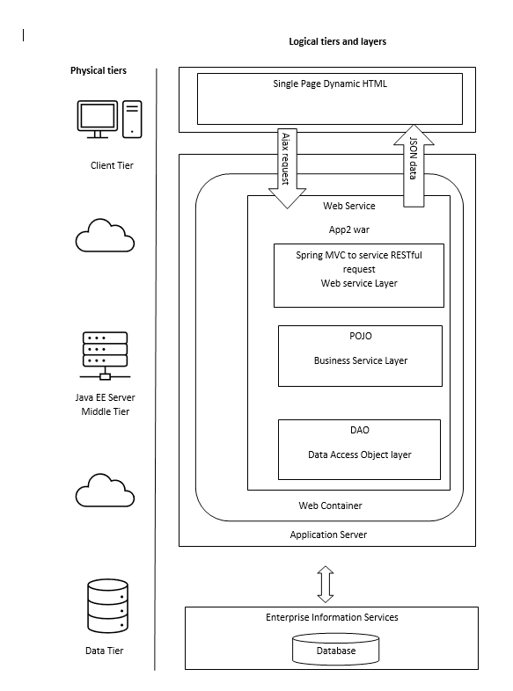
SRS - Solution Design

Slide 15
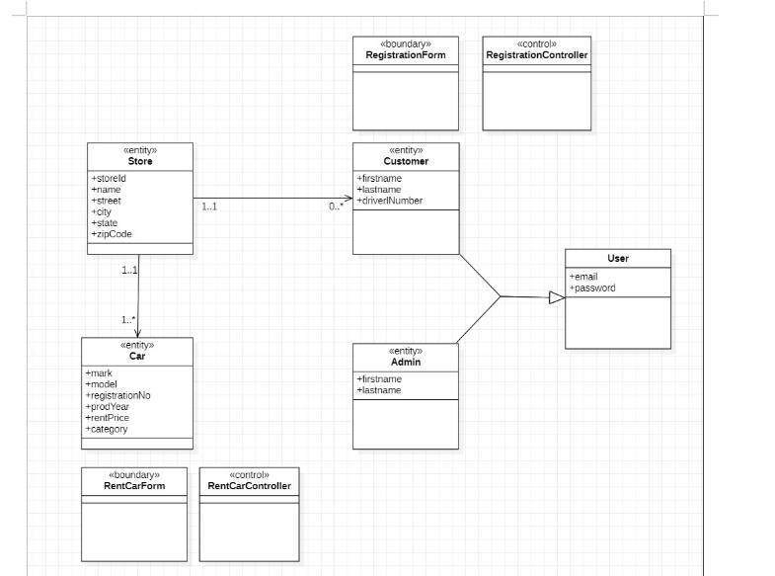
SRS - VOPC Diagram

